Slide 1
Take charge
of your finances

Slide 2
Main Content
Get money on your side
Your money Mindset
Track: Know where you are
Target: Know where you going
Trim: Align Actions with Priorities
Train: Develop healthy money habits

Slide 3
TAKE CHARGE OF YOUR FINANCES
 | 5 | 5 |  | Introduction
36 |  | 5 |  | Get money on your side
 | 5 | 10 | healthy money management
 | 5 | 15 | personal spending record
 | 5 | 20 | personal revenue record
37 |  | 20 |  | Your money mindset
 | 5 | 25 | understanding your money mindset
 | 10 | 35 | group survey
38 |  | 35 |  | TRACK know where you are
 | 5 | 40 | tracking skills
 | 15 | 55 | group survey
 | 5 | 60 | spending triggers
39 |  | 60 |  | TARGET know where you are going
 | 5 | 65 | your smart targets
 | 5 | 70 | individual survey
40 |  | 70 |  | TRIM align action with priorities
 | 5 | 75 | how spending change your wealth
 | 5 | 80 | individual survey
 | 5 | 85 | events to change
 | 5 | 90 | individual survey
41 |  | 90 |  | TRAIN develop healthy money habits
 | 5 | 95 | how to be financially strong
 | 5 | 100 | individual survey
 | 15 | 115 | key money concepts
 | 40 | 155 |  | Expert Experience
42 |  | 155 |  | Start early finish strong
 | 10 | 165 | time is money
 | 10 | 175 | money and business
 | 5 | 180 |  | Conclusion

Slide 4
GET MONEY
ON YOUR SIDE
This course is about Money Management/Awareness.
How money can help you to achieve your goals
To know yourself
Apply healthy money-management skills to improve your well-being.

Slide 5
APPLY HEALTHY MONEY MANAGEMENT SKILLS
The cycle of life : to make money, to spend money
Do a parallel with health management, but money management
To have access to “better” life
To have more choices
To have less stress
Objectives : best practices in personal finance to think and act
Get some financial knowledge

Slide 6
PERSONAL SPENDING RECORD
List ways of spending
money

Slide 7
SPENDING MONEY
Daily life : food, health, clothes, phone
House : rent
Transport
School, university fees
Services : maid, nurse, lawyer, accountant, driver
Leisure : culture, holidays, cigarettes, books
Special : wedding, birth
Gifts, charity
Taxes

Slide 8
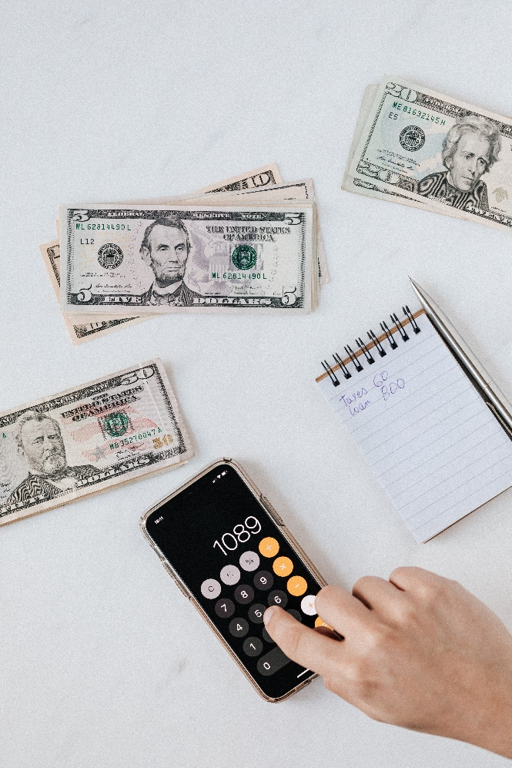
PERSONAL SOURCES OF REVENUES
List possible (legal) source of revenues

Slide 9
SOURCES OF MONEY As: Revenues
FROM WORK
Salary from working activities
Allowances
TRANSFER
Pensions
Gifts from family/friends
FROM CAPITAL
Rent from houses (real estate)
Financial revenues : interests, dividend

Slide 10
YOUR MONEY MINDSET
The attitudes you have toward money change how you interact with money.
Changes in your financial attitudes have a tremendous impact on your behavior and, consequently, can improve the results you get.
How to know oneself
Can you change your mindset

Slide 11
Understanding your money mindset
How have these areas affected how you think about money?
CULTURE
FAMILY
FRIENDS
SOCIAL MEDIA

Slide 12
MONEY MINDSET
Parents attitude and awareness
Past history
Philosophy about life, priorities and goals
Divorce: how to decide about the consequences
How to compare, with friends, neighbors, parents, brother/sisters
Value of a job now

Slide 13
1. TRACK: Know where you are
Measures and identify spending
List the different means of payments
What are the bank services to use for money management
What are good
tracking skills?

Slide 14
TRACK As: Listing the Past Events
GOOD TRACKING HABITS
The role of means of payments
Controls regularly bank accounts
Forecast like treasurers
Compare between years
Identify recurrent from exceptional
Classify all flows: spending, investing/saving, transfers
Have your own ratios: debt, return, taxes

Slide 15
SPENDING TRIGGERS / PRINCIPLES
Emotional
Social
Visual
Physical
Needs vs wants
Trade off
Opportunity costs
Instant/delayed gratification

Slide 16
2. TARGET: Know where you’re going
TARGET RANGE
____________ _________
SHORT RANGE < 1 year
MID RANGE 2 – 4 years
LONG RANGE > 5 years
Fund post secondary education
Establish an emergency fund
Buy a computer / a car
Save to move out
Take a dream vacation

Slide 17
2. TARGET SMART
S: Specific
M: Measurable
A: Achievable
R: Relevant
T: Time based
How to evaluate priorities?

Slide 18
TARGET as: Evaluating Priorities
TARGET :
name/description
cost/value
horizon
probability
dependances
Buy cars, house, computers
Start a company, a fintech
Enroll courses, universities
Go round the world
Get married, have kids
Move away from parents

Slide 19
3. TRIM: Align Actions with Priorities
SPENDING PLANS
Income / Revenues
Fixed Expenses
Variable Expenses
Discretionary spending
Personal Budget Plan
How spending change your wealth?

Slide 20
TRIM as: Adjusting Planned with Actual
To spend money is:
(give examples)
Consuming
Replacement
Transfers
Others?

Slide 21
3. TRIM: Align Actions with Priorities
SPEND WITH POWER
Spending money requires permanent
decisions and adjustments
We have to react quickly
What are events that force you
to change?

Slide 22
TRIM as: Forecasting the Future
UNCERTAINTY / EVENTS
Loss of job
Dispute: family, friends
Economic crash, inflation
Ecological disaster
Covid 19
Need for SAVINGS to be able to face uncertain EVENTS

Slide 23
3. TRIM: Align Actions with Priorities
THE CHOICE IS YOURS
Tracking - past
Targeting – future
Trimming – present choices
Budgeting !

Slide 24
4. TRAIN: Develop Healthy Money Habits
How to be:
“Financially Strong”?

Slide 25
EXPERTISE As: This is becoming an Expert in some fields.
What to do:
Be expert in your career:
Be expert in some domains: stocks, arts, …
Take actions in investments: buying/selling at the right time
Develop Firms: management, finance, accounting, operations, it,…

Slide 26
4. TRAIN KEY MONEY CONCEPTS
Saving / Investing
Principle/Interest
Present/Future Value: time value of money
Inflation

Slide 27
4. TRAIN KEY MONEY CONCEPTS
Credit Score / Rating / Debt
Education / Income
Simple Interest
1000 usd . 7 years . 10%/year = 700 usd
Compound Interest per year
1000 usd . (1+10%)^7= 1948,72 usd
Interest is 948,72 usd
What is if monthly compounding?

Slide 28
FINANCIAL CONCEPTS As: This is Finance!
Others Concept important for Personal Finance.
Buy/Rent
Invest Capital/Have Debt
Risk/Return
Liquidity = availability
Monthly compounding:
1000 . (1 + 10%/12) ^ (7*12) = 2007,92
Interest: 1007,92 usd (instead of 948,72)

Slide 29
4 « T » LAWS OF MONEY MANAGEMENT

Slide 30
Time is money
Then, use time efficiently is key.
We use our time for what?

Slide 31
TIME IS MONEY As: How to be more productive
Biological needs
Working to make money
Leisure and Culture
To help others

Slide 32
Making Money through Business
What are the differences between these Economic Actors in terms of Money Management?
Individuals (you)
Firms
State

Slide 33
MANAGE INDIVIDUALS AS FIRMS ? As: Is that really the same?
THE KEYS BUSINESS REPORTS ARE:
CASH FLOW STATEMENT
INCOME STATEMENT
BALANCE SHEET
Missing:
Ecological footprint!

Slide 34
THANK YOU FOR YOUR ATTENTION

